Slide 1
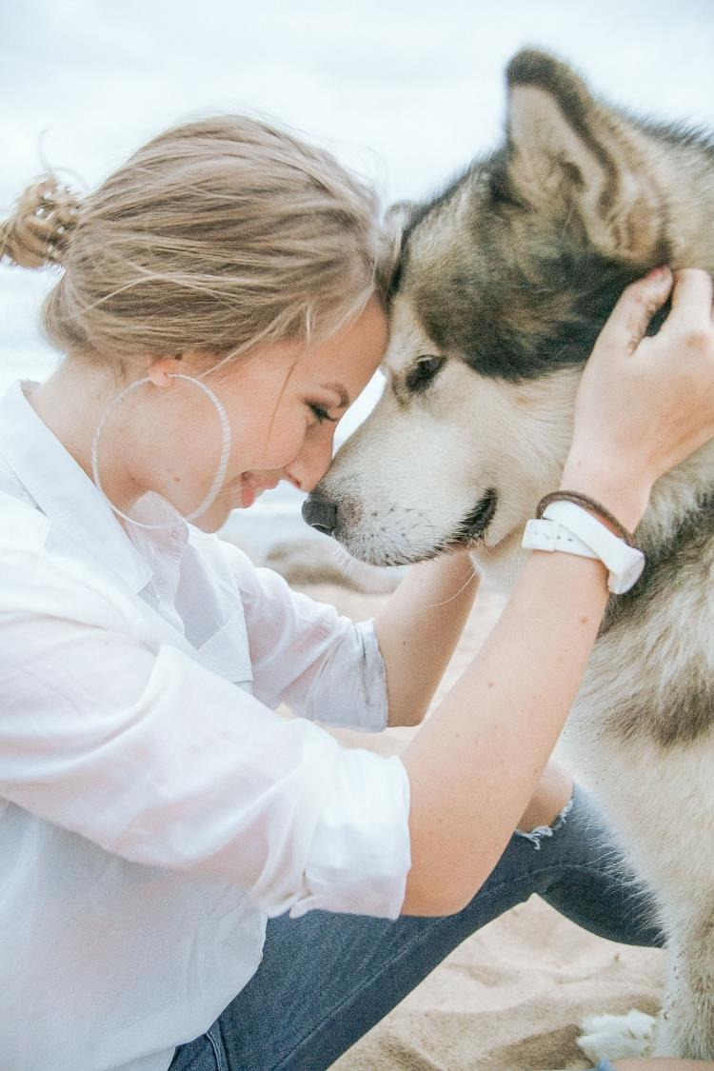
Statement by
Georg Müller
Chair of the Industry Association of Pet Care Producers (IVH)
at the press conference for Interzoo 2022
on 24 May 2022, 9.30
Exhibition Centre Nuremberg
IVH
Industrieverband
Heimtierbedarf (IVH) e.V.

Slide 2
Turnover by Sales Channel (Only Brick & Mortar Trade)

Slide 5
Raw ingredients – price development
Beef fat
€/100kg
Poultry meat powder
€/100kg
€/100kg
Wheat
ct/kWh (incl. electricity tax)
Energy

Slide 6
Sustainability in the pet supplies industry
IVH & Sustainability
Development of a sustainability strategy
Survey among IVH members
Close collaboration with FEDIAF
Calculation of ecological footprint of pet food at EU level since 2014
Numerous information sessions
Collaboration with experts

