Slide 1
Statement of
Dr Rowena Arzt
Head of Exhibitions, WZF – Pet Industry Services

Slide 2
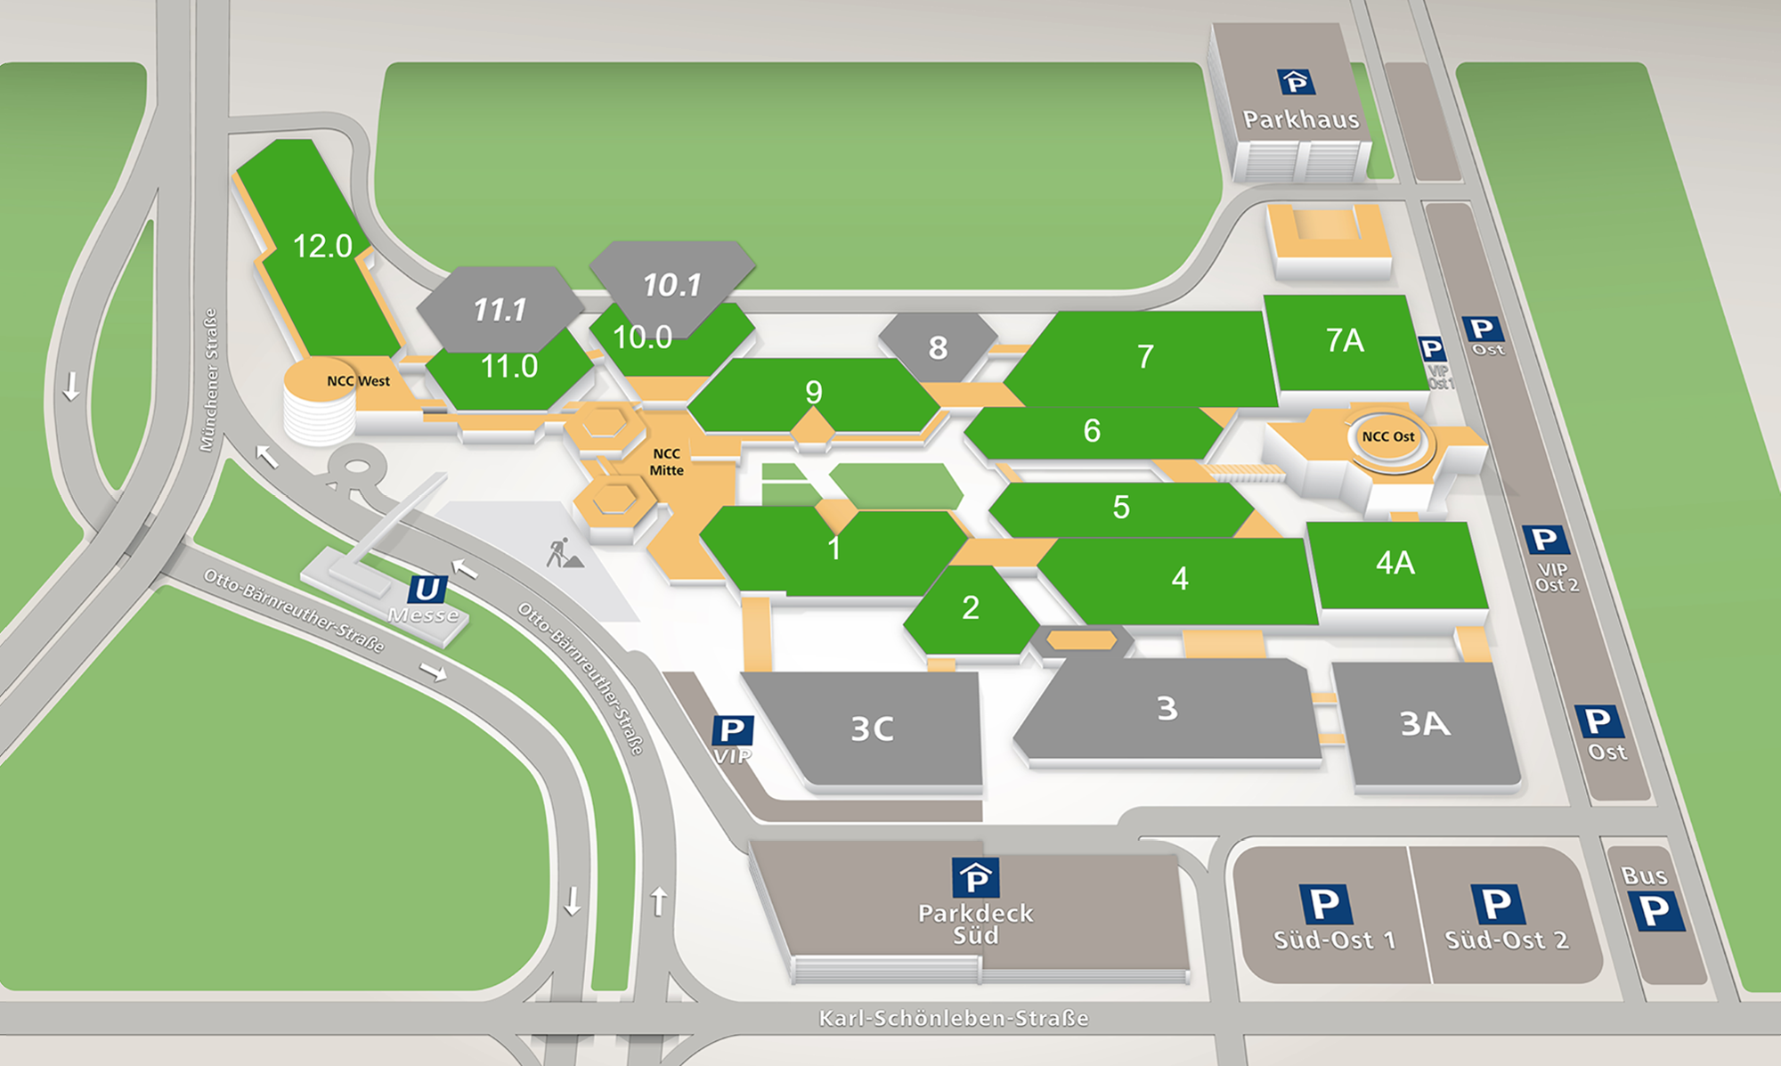
12 Exhibition halls and 3 entrances

Slide 3
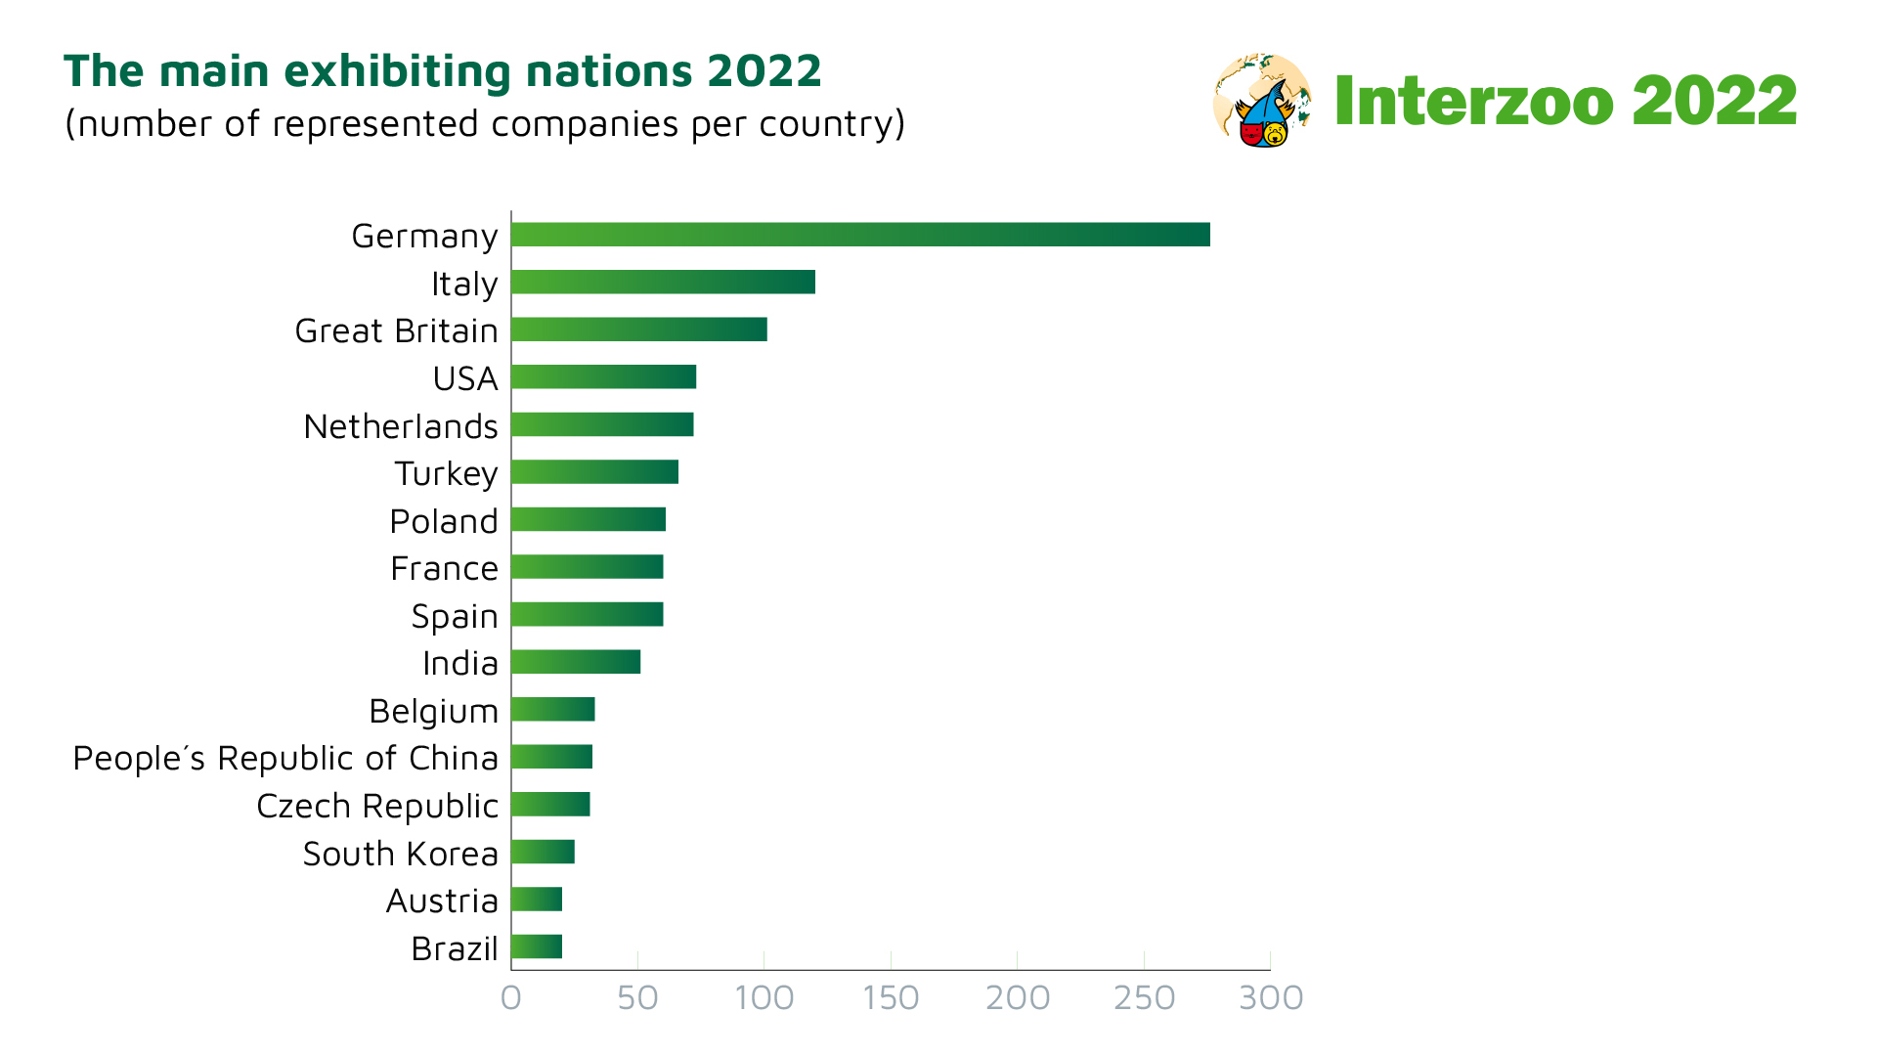
More than 1,300 exhibitors from 60 countries
Visitors registered from 127 countries

Slide 4
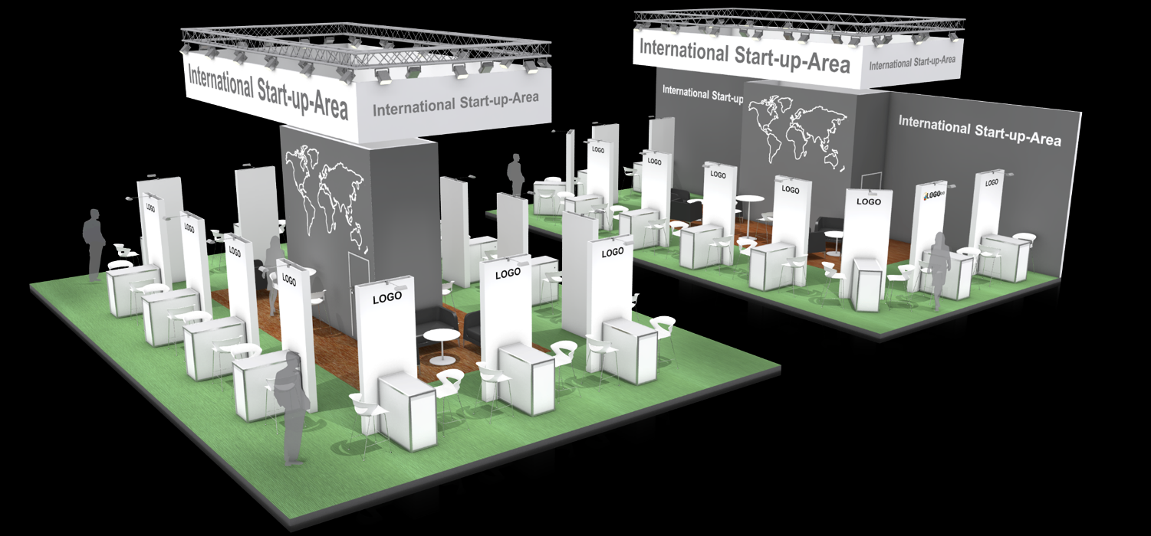

New opportunities for start-ups
Pavilions and Fresh Ideas Stage in Hall 11
700 sqm exhibition space dedicated to
start-up companies
German Start-up Pavilion sold out
New: International Start-up Pavilion
New: Fresh Ideas Stage with presentations from Wednesday - Friday
New: Interzoo Fresh Ideas Contest on Friday 27 May from 11:30 – 13:00

Slide 5


Interzoo Sustainaibility Initiative
Started by ZZF/WZF in 2018
Aim: to gather information on the status and the development of sustainability related aspects in the pet supplies industry
Interzoo Sustainability Session Today from 1:00 – 3:00 pm,
room St. Petersburg, NCC Ost
Sustainability Study available on Interzoo-Academy

Slide 6
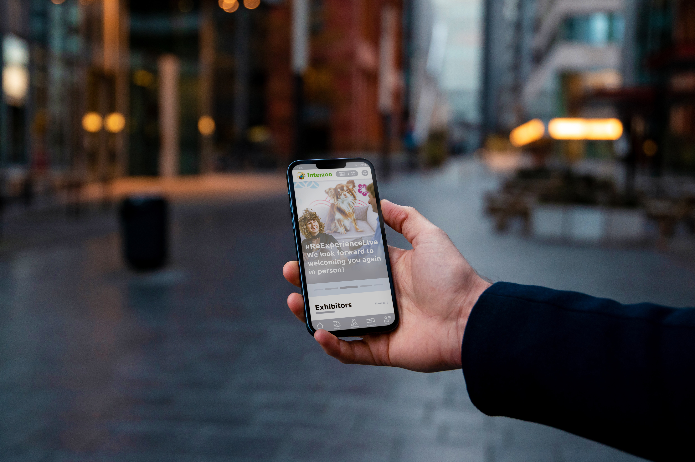

New Interzoo App
Connecting the physical and the digital trade fair experience

Slide 7
Interzoo 2022
Meet the international
pet supplies industry!

